Slide 1
Linux

Slide 2
graphical user interface

Slide 3
GUI

Slide 4
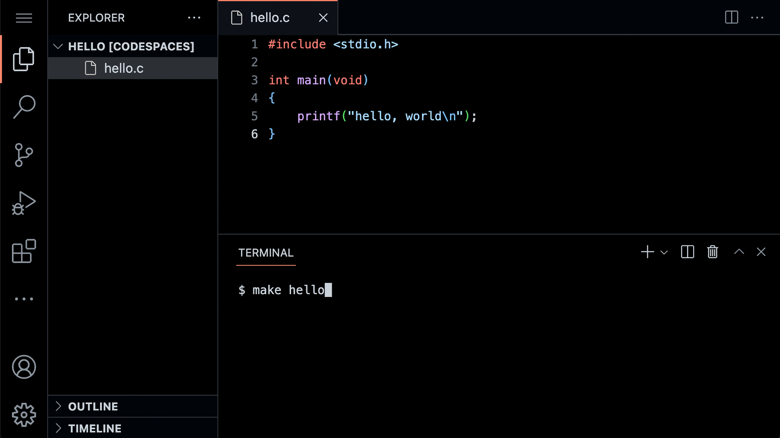

Slide 6
command-line interface

Slide 7
CLI

Slide 8
cd
cp
ls
mkdir
mv
rm
rmdir
...

Slide 9
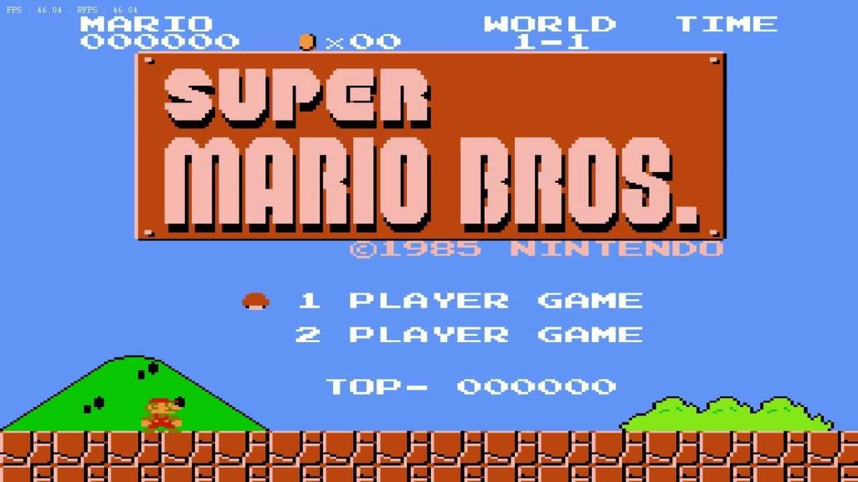

Slide 10


Slide 11
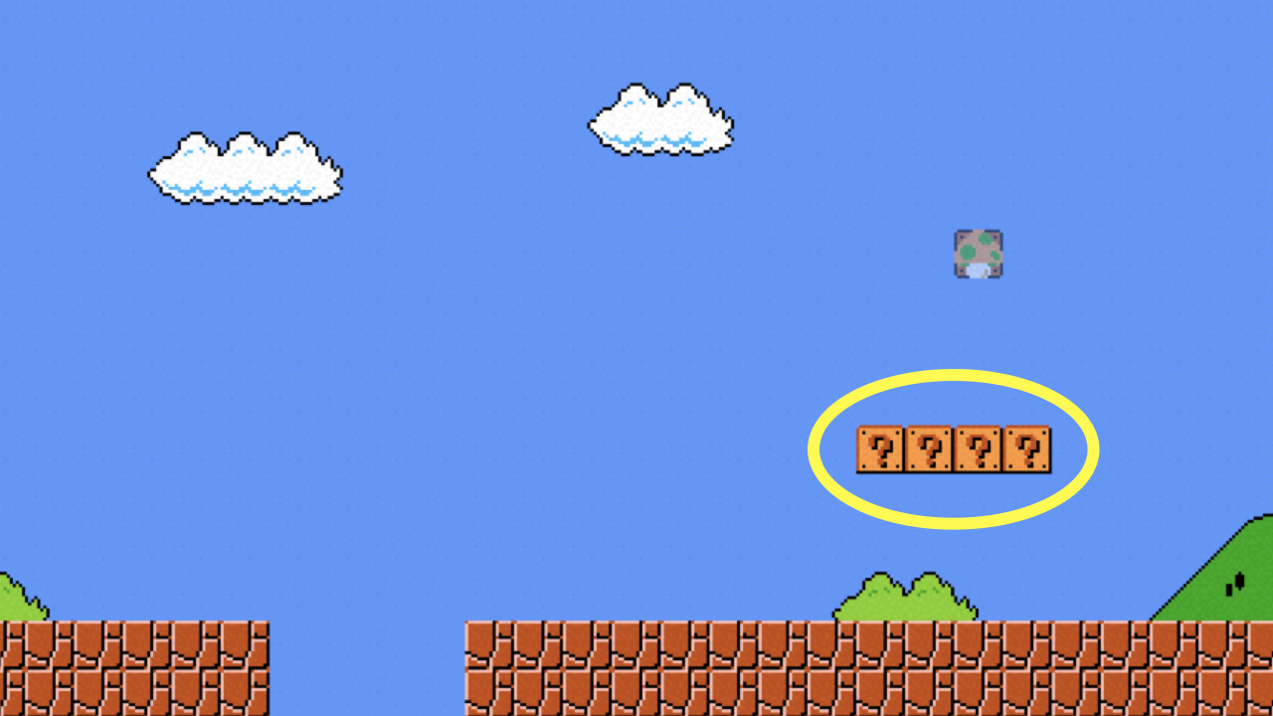

Slide 12
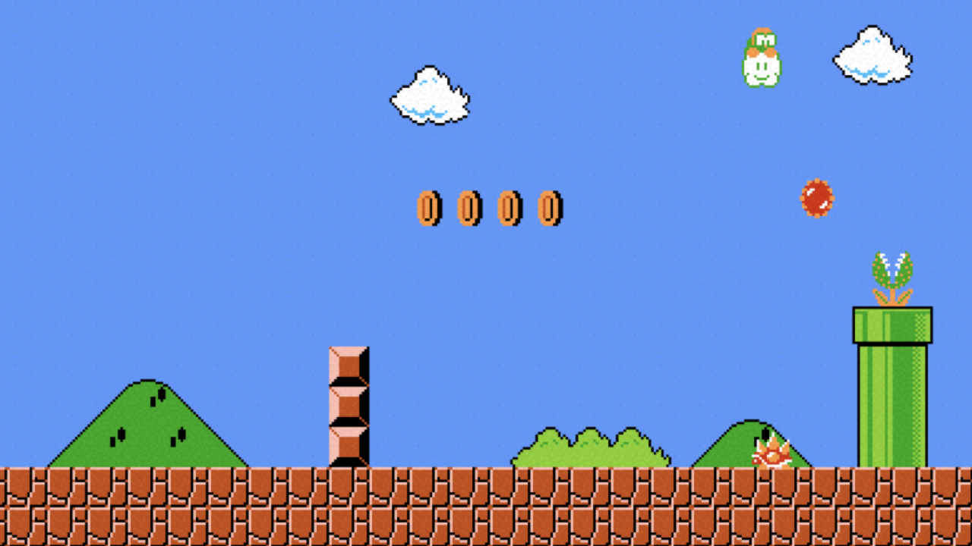

Slide 13
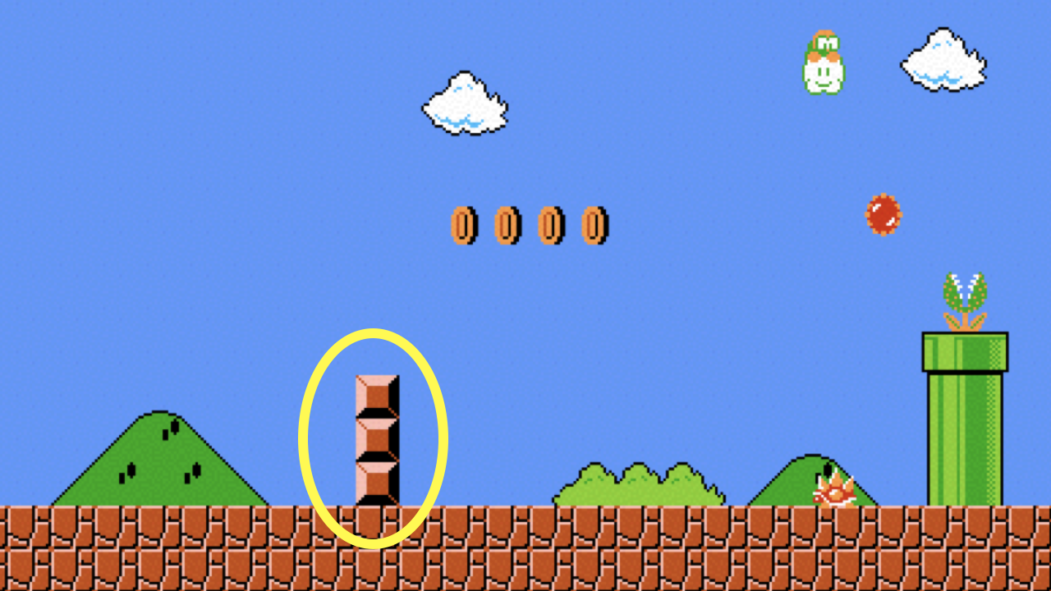

Slide 14
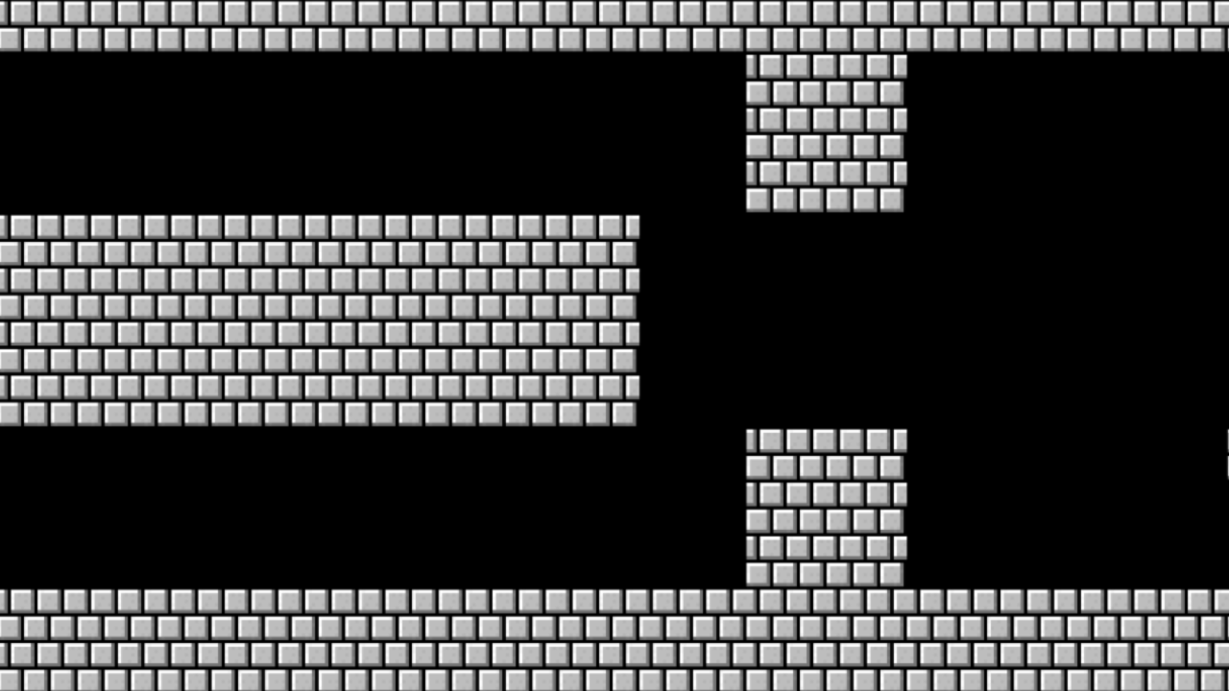

Slide 15
